Slide 1
Annual General Meeting
Tuesday 26th November 2019
​
focrg
www.
.org.uk

Slide 2
Friends of Chislehurst Recreation Grounds (FOCRG)
We …
Are all volunteers and give our time freely
Live locally and know our neighborhood
Meet regularly and work closely with idVerde the Park Management company.
Work hard to promote the Rec as an important facility for the Chislehurst Community.
Provide a voice for Rec users in dealings with London Borough of Bromley
LATEST MEMBERSHIP…834… AND COUNTING! (558 households)

Slide 3
Agenda
Introductions
Apologies for Absence
Election/re-election of committee members
Treasurer’s Financial Report Julie Covill
Approval and appointment of independent examiners
Chairman’s Report – our achievements and our visions
Updates and discussion on the following:
Chislehurst Rocks Rachelle Harte
Gardening Club Mai Bunce
Social Media Pia Burbidge
AOB
Close of meeting 8.30pm

Slide 4
FOCRG Committee
Barbara Arora – Chair
Alison Stammers – Secretary
Julie Covill – Treasurer
Rachelle Harte – Events Manager
Ian Douglas – Consultant Engineer (and General Factotem)
Pia Burbidge – Social Media Manager
Mai Bunce – Gardening Club manager
Clive Richardson – Committee member
Alison Julie Pia Ian

Slide 5
Behind the Scenes Committee Associates
The committee wants to thank:
Matt Male - Web Master
Alan Bunce – super volunteer
Fabio Rossi - Delegated Sports Manager
Dale Malcolm – Safer Neighbourhood Team CAP Representative
The Visit Chislehurst publicity team
Mattison & Co Accountants

Slide 6
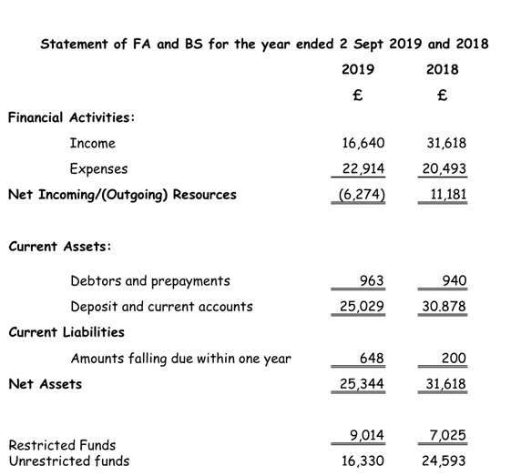
Treasurer’s Report
Julie Covill

Slide 7
Chislehurst Rocks
2019
CLEAR Synergy
Inclusion
New/old venue
Record numbers of visitors
Reported as "Best Ever"
2020
Date currently 13th June 2020
10th year celebrations
Fund raising

Slide 8
Chislehurst Rocks
With Grateful thanks to:
All our sponsors
All our 100 Club Members
Volunteers from Sainsburys Chislehurst
Derek Nash
Robert Pwiko Photography
Our amazing first aiders led by David Ely
Idverde
FOCRG
In the Wings
Stewart Markworth
Scouts
Elmstead FC
All our friends and family that contributed towards the event

Slide 9
FOCRG Gardening Club
Started on 1 May 2019
The number of volunteers ranges from 3 to 10 but mostly there are 5 -6
The total of volunteer hours = 280 hours [242 hours gardening and 38 hours watering]
New garden shed in the Invicta Scout’s ground. Funded by grants from Chislehurst Society and Bromley Friends Forum and FOCRG. Installed by volunteers from FOCRG and Invicta, supported by local builder Dan Crossfield

Slide 10
Gardening Club
Our thanks to
Our volunteers who turn up in all weathers
ACES Work Wear – who supplied our hi-viz Jackets – gratis
Chislehurst Society and FOCRG for funding the planters
To idVerde for supplying plants for the planters - gratis
To idVerde for supplying compost for the planters - gratis
To Chislehurst Society and Bromley Friends Forum for funding the shed and for some tools
FOCRG for supplying tools
To the Roost for allowing half price drinks to members of the gardening club on gardening days
To park users who have donated plants gardening club

Slide 11
Social Media update
Where ?
Twitter, Facebook and Instagram
3010 followers and Facebook up 54% since last AGM !
Follower Profile
Female aged between 35-44 followed by a 45-54 year old
What We Post
General Information
Wildlife and Foraging with Friends.
Tips and advice e.g. keep pets safe during firework display reached 99,000 people
Advertise for businesses in the Rec. (Tai-Chi, Pilates, Tennis, Bootcamp ect)
Campaigns
Blitz the butt
World clean-up day
Paws on plastic
The big butterfly count
Reduce/Reuse campaign with cups and bottles in the Roost and our water fountain
Like our page and our posts

Slide 12
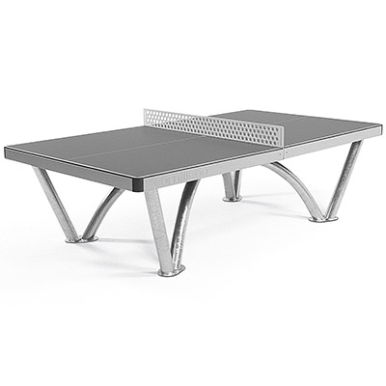
Spring 2020 Outdoor table tennis
Outdoor table tennis tables x 2.
Total cost with VAT £10965 Grant of £8980 from the Chislehurst Playing Field Association.

Slide 13
