Slide 1
Annual General Meeting
Monday 26th November 2018
focrg
www.
.org.uk

Slide 2
Agenda
Introductions
Apologies for Absence
Election/re-election of committee members
Treasurer’s Financial Report
Approval and appointment of independent examiners
Chairman’s Report – our achievements and our visions
Updates and discussion on the following:
Rec improvements
Suggestions for events and activities
A more regular gardening group?
AOB
Close of meeting 9.00pm

Slide 3
Friends of Chislehurst Recreation Grounds (FOCRG)
We …
Are all volunteers and give our time freely
Live locally and know our neighbourhood
Meet regularly and work closely with idVerde the Park Management company.
Work hard to promote the Rec as an important facility for the Chislehurst Community.
Provide a voice for Rec users in dealings with London Borough of Bromley
LATEST MEMBERSHIP…557… AND COUNTING! (826 households)

Slide 4
Our Aims
We want to:
Preserve and enhance the environment of Chislehurst & Walden Recreation Grounds for the benefit of the local community
Encourage greater use of the facilities by the community, whilst discouraging anti-social behaviour
Invite members and local residents to become involved in activities within Chislehurst & Walden Recreation Grounds, so that they can contribute to its development
Raise funds to enable these objectives to be achieved

Slide 5
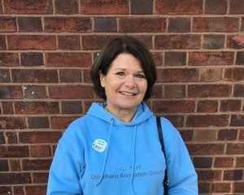
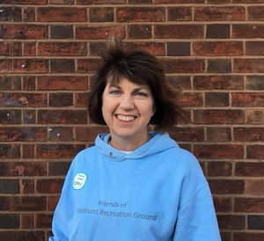
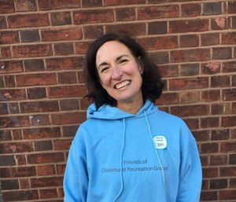
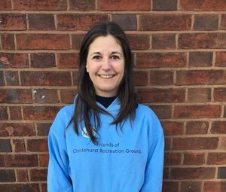
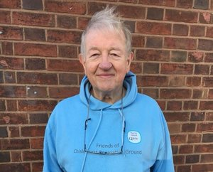
FOCRG Committee
Barbara Arora – Chair
Alison Stammers – Secretary
Julie Covill – Treasurer
Rachelle Harte – Events Manager
Ian Douglas – Consultant Engineer (and General Factotem)
Pia Burbidge – Social Media Manager
Alison Julie Pia Ian

Slide 6
Behind the Scenes Committee Associates
The committee wants to thank:
Matt Male - Web Master
Mai & Alan Bunce – super all round helpers
Fabio Rossi - Delegated Sports Manager
Dale Malcolm – Safer Neighbourhood Team CAP Representative
The Visit Chislehurst publicity team
Mattison & Co Accountants

Slide 7
Financial Update
Registered Charity No 1163405
Registered 3 September 2015
Financial year end 2 September. All reports submitted to the Charities Commission
Gift Aid – the reward for being a registered charity and submitting those reports
Treasurer’s Report

Slide 8
Treasurer’s Report
Statement of Financial Activities for the year ended 2 Sept 2018 and 2017
 |  | 2018 |  | 2017
 |  | £ |  | £
Incoming Resources:
 | Donations | 9,261 |  | 10,322
 | Interest | 28 |  | 72
 | Activities for generating funds:
 | Events | 7,454 |  | 9,264
 | Grants | 14,421 |  | 1,751
 | Total Incoming Resources | 31,674 |  | 21,409
Resources Expended:
 | Cost of generating funds | 126 |  | 1,224
 | Event expenses | 19,643 |  | 14,781
 | Park improvements | 724 |  | 3,000
 | Total Resources Expended | 20,493 |  | 19,005
Net Incoming/(Outgoing) Resources |  | 11,181 |  | 2,404
Julie Covill
Notes:
Grants included £2771 from Chis Co-op for Chis Rocks, £1K from Chis Soc for Chis Rocks, £8,150 from A4A, and £1K from Southern Co-op, £1550 for water fountain.

Slide 9
Over £130K Grant funding to date (2011-2018)
Playground £42,000
Fitness trail £18,306
Olympic Closing Party £3,000
Santa Christmas Grotto £2,000
Portable Lights £3,600
Accessible Roundabout £13,250
Chis Rocks! £46,388
Co-op (fountain) £1,751
Drinking Fountain Association £1250
Chislehurst Rotary (Fountain) £500
Chislehurst society (planters) £500

Slide 10
Treasurer’s Report
Statement of Assets and Liabilities as at 2 Sept 2018 and 2017
 |  | 2017 |  | 2017
 |  | £ |  | £
Current Assets:
 | Debtors and prepayments | 940 |  | 1,024
 | Deposit and current accounts | 30.878 |  | 20,063
Current Liabilities
 | Amounts falling due within one year | 200 |  | 650
Net Assets |  | 31,618 |  | 20,437
Restricted Funds Unrestricted funds |  | 7,025 |  | 2,626
 |  | 24,593 |  | 17,811
Notes:
Restricted funds are £3,301 for drinking fountain and £3,724 for Chis Rocks.

Slide 11
Review of FOCRG’s 8th Year Good points
We’re well established as the eyes and ears for the Rec community
Continued to raise our profile on social media and disseminate accurate information about the Recs
799 Facebook Followers
Chairman’s Report

Slide 12
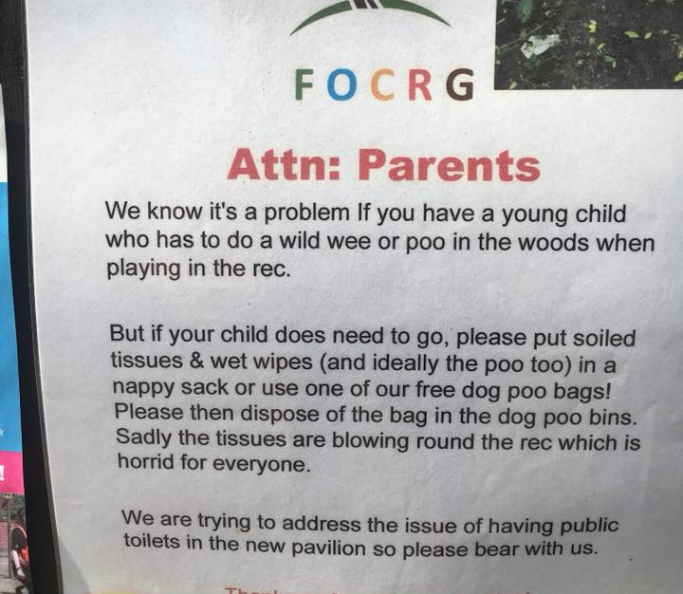
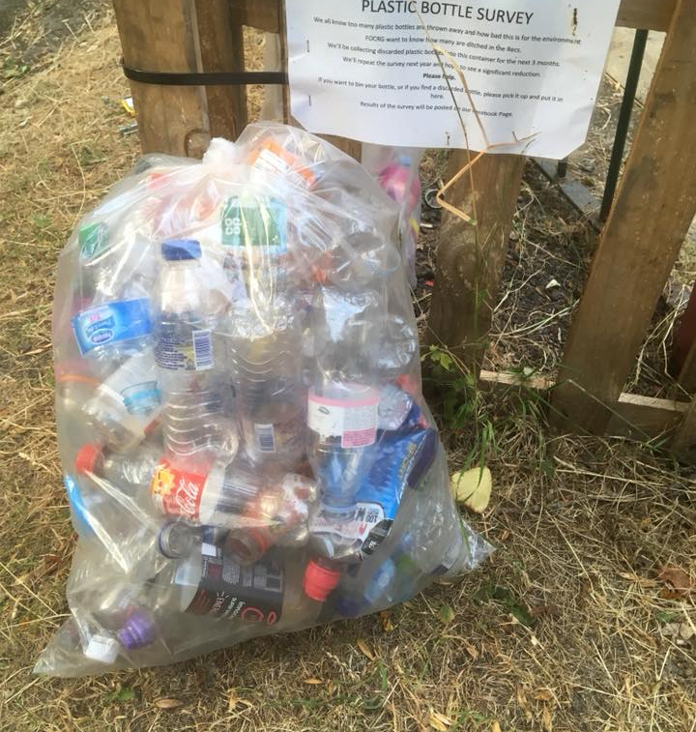

Slide 13
But……..
The number of regular hands-on volunteers remains disappointingly low.
Excluding Chislehurst Rocks, the committee and other volunteers gave about 1250 hours to Rec-related improvements and activities. About 80% by the Committee

Slide 14
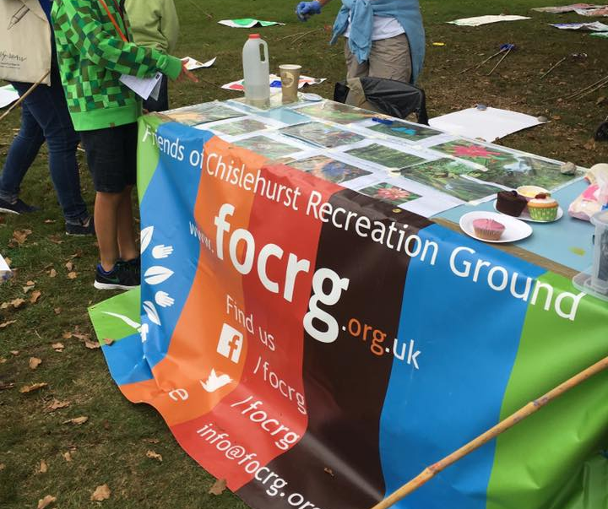
Where did that time go?
LIAISON WITH
idVerde – planning park improvements, reporting problems.
Visit Chislehurst – publicity
Chislehurst Town Team and CBG - Video with April’s Kitchen (fun!)
Chislehurst Society - Bird Sanctuary Project
Chislehurst Rotary – Summer Fair & Fireworks
Chislehurst 1st Guides, Brownies & Rainbows – Rec maintenance projects
Chislehurst 5th Cubs – gardening & environmental projects
Chislehurst Invicta Scout Group
Tennis Club, FC Elmstead
The Edge Youth Club – loan of equipment
Bromley Friends Forum - meeting with other Friends Groups
Safer Neighbourhood Police Team – reporting ASB issues, attending CAP meetings.
FUND RAISING
Identify suitable grants and write applications
Follow up spending and give feedback to funders
SIMPLE MAINTENANCE TASKS

Slide 15
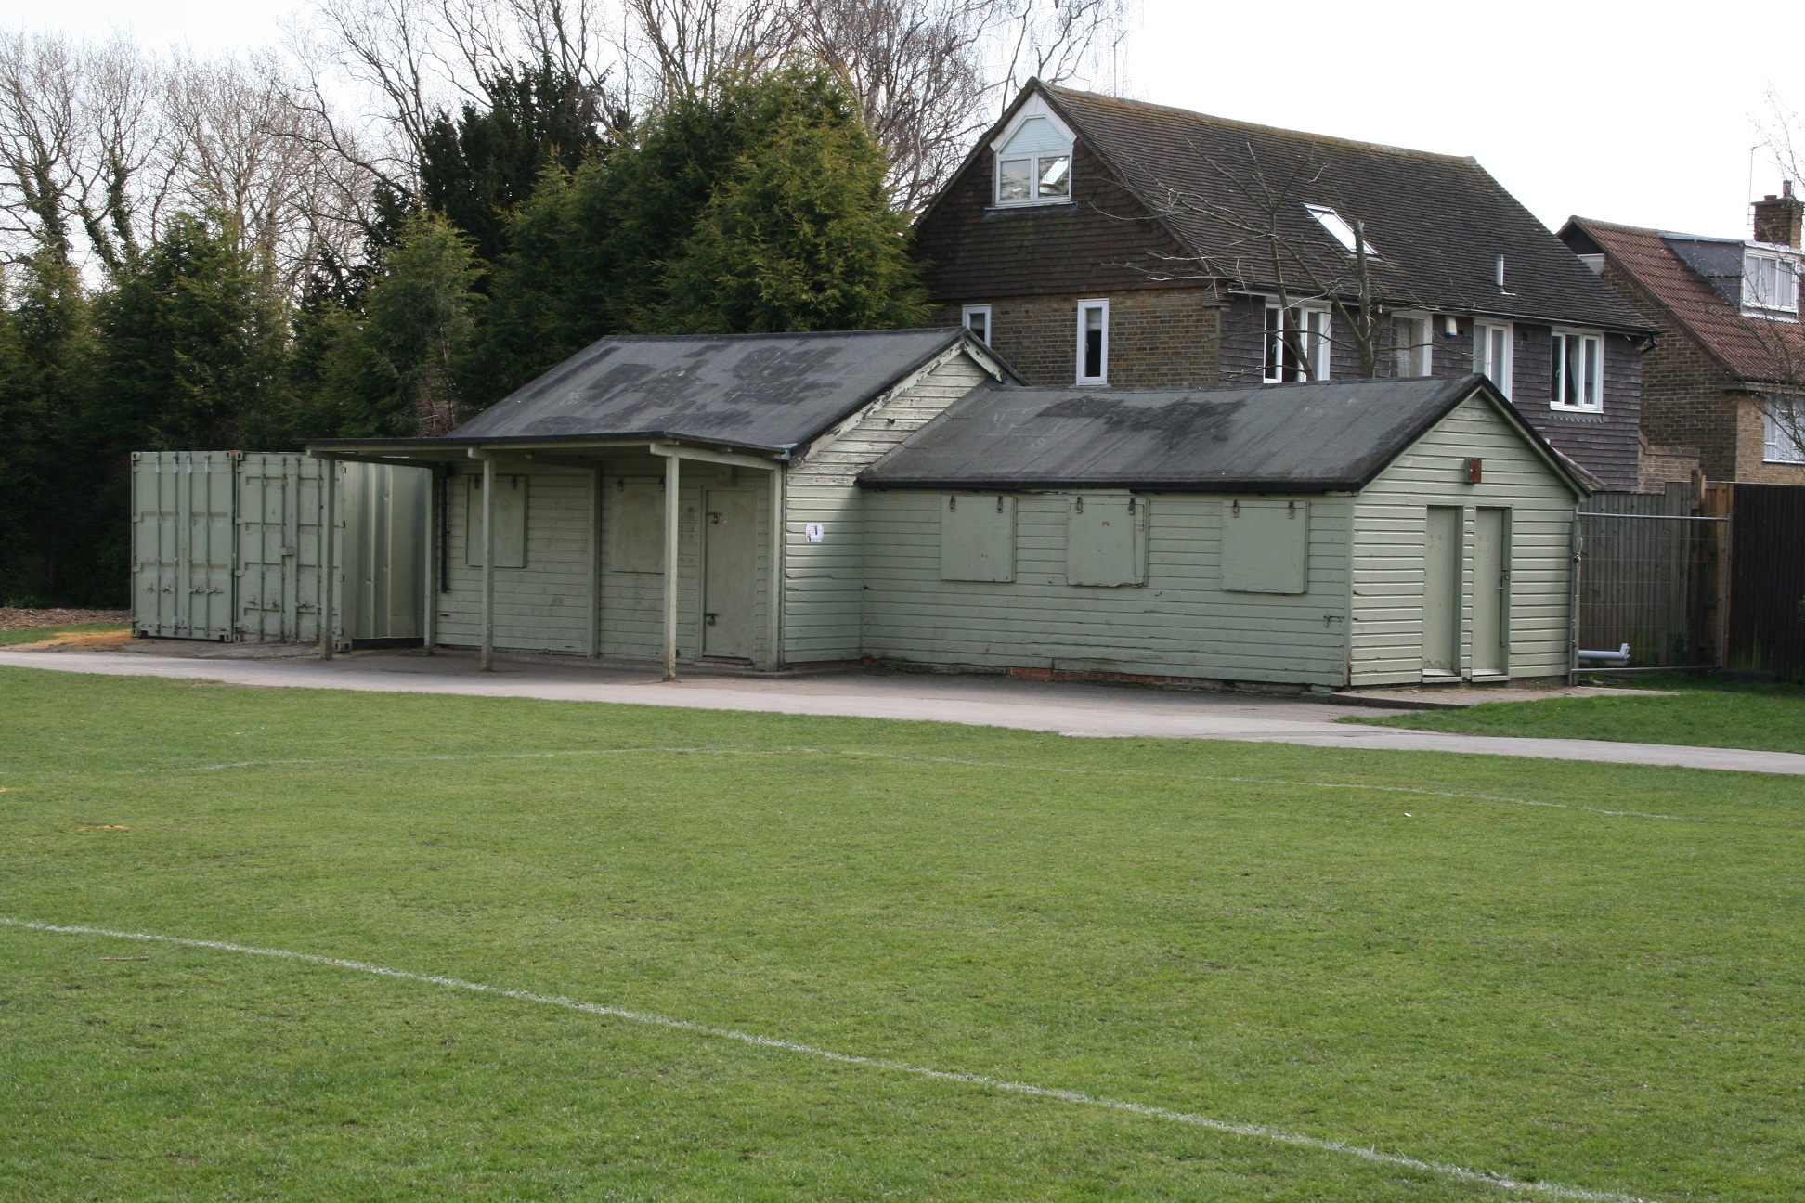
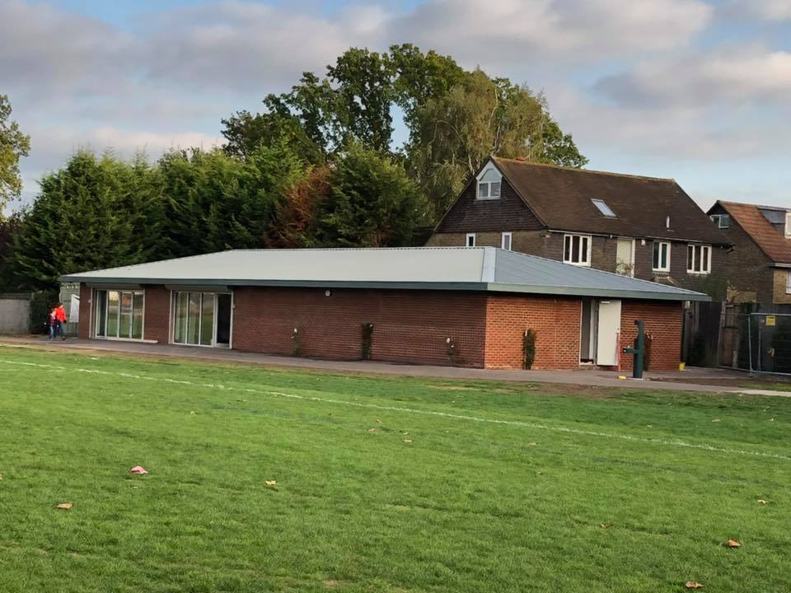
Park Improvements 2018
What can we say ?
Thank you Fabio
and FC Elmstead for seeing this through

Slide 16
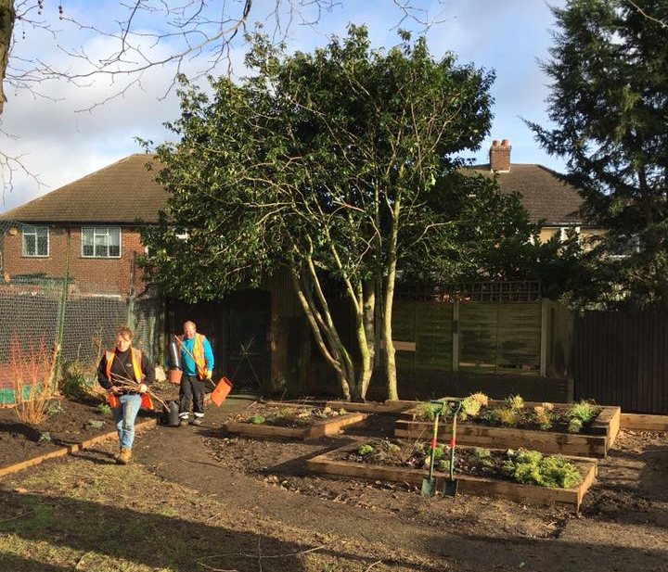
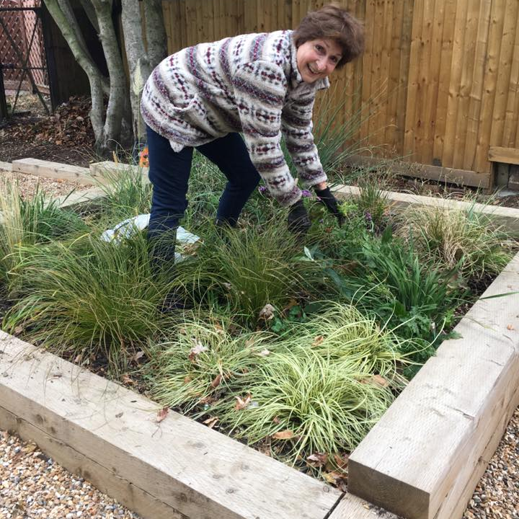
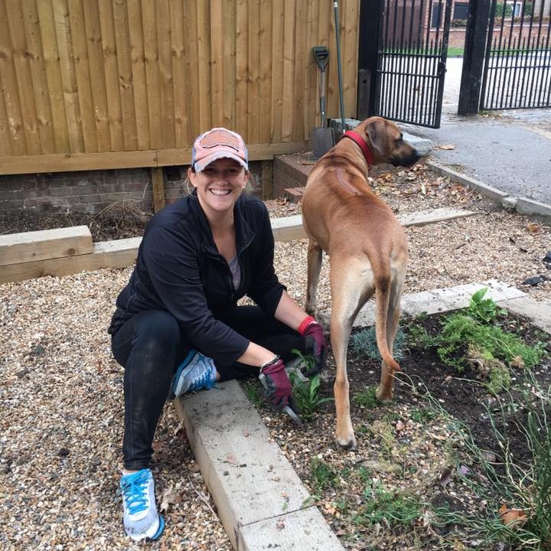
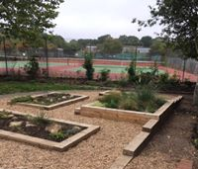
Other Park improvements 2018
Improved planting around Empress Drive Entrance
Thanks to idVerde.
FOCRG volunteers, with local Cubs and Brownies, help to maintain.
Notes:
“Kids at Play – Keep Poop away” campaign – led by FOCRG. Donations of bags from Pets at Home. Ticspac dispenser funded by local sponsors including PetPals. Dispensers refilled by FOCRG volunteers.

Slide 17
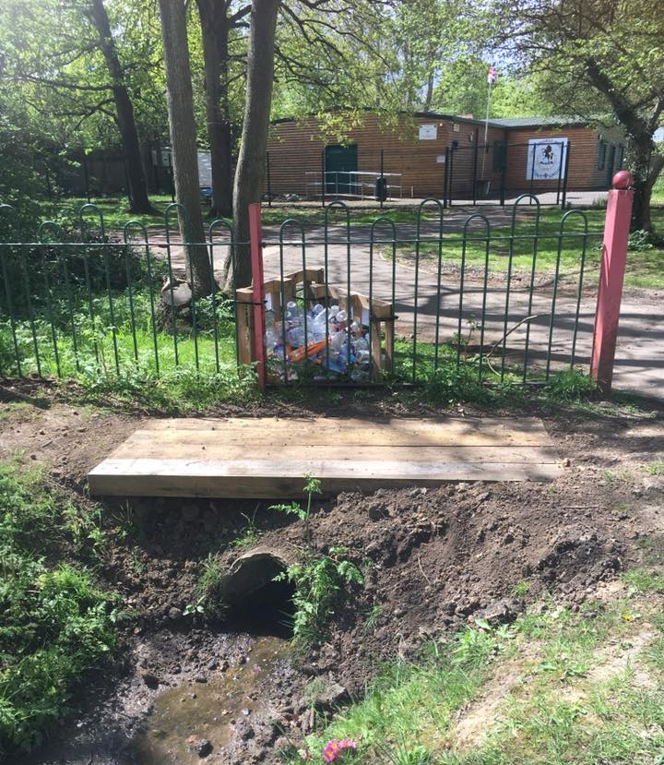
New bridge over ditch
THANK YOU

Slide 18
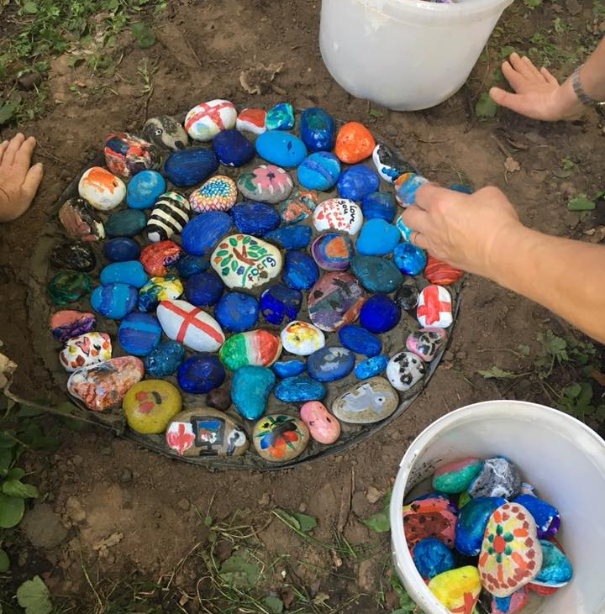
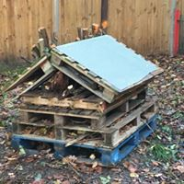
SHADE GARDEN PROJECT Rock “pools”, habitat haven, planting bulbs, wildflowers and ferns

Slide 19
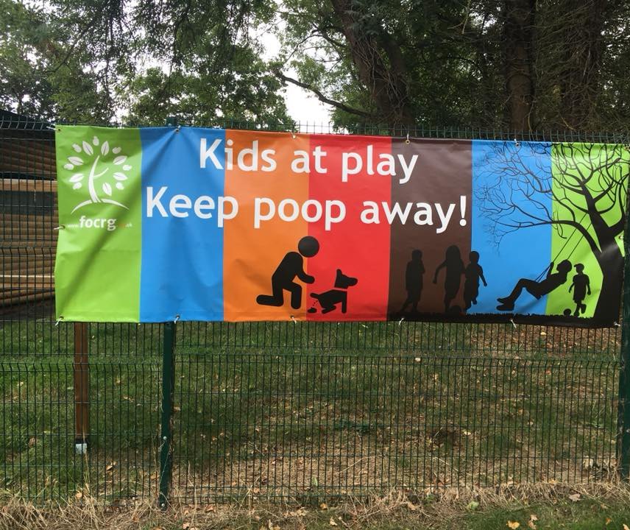
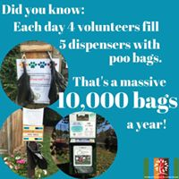
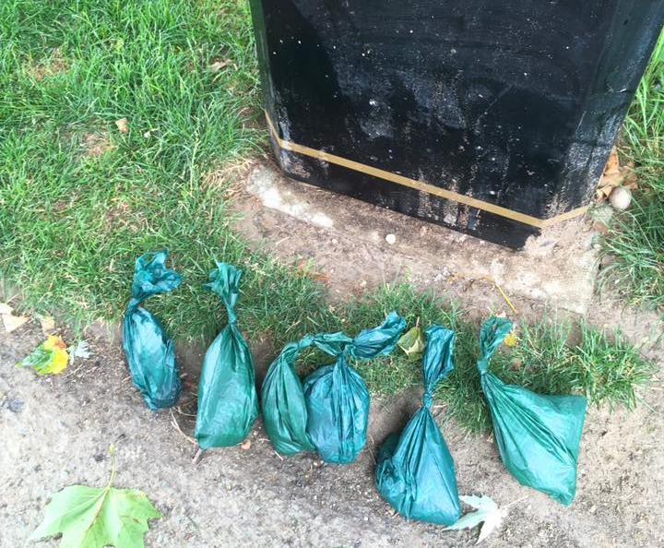
“Keep Poop Away” Campaign
Poo Bags sponsored by
Pets at Home
Tikspacs sponsors including Chislehurst Pet Pals

Slide 20
Drinking water fountain
Funded by:
Co-Op in Green Lane
The Drinking Fountain Association
Chislehurst Rotary

Slide 21
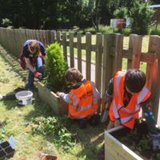
New Planters
By notice boards and in playground – funded by the Chislehurst Society
. Maintained by FOCRG with help from Cubs and Brownies.
Plants supplied by idVerde.

Slide 22
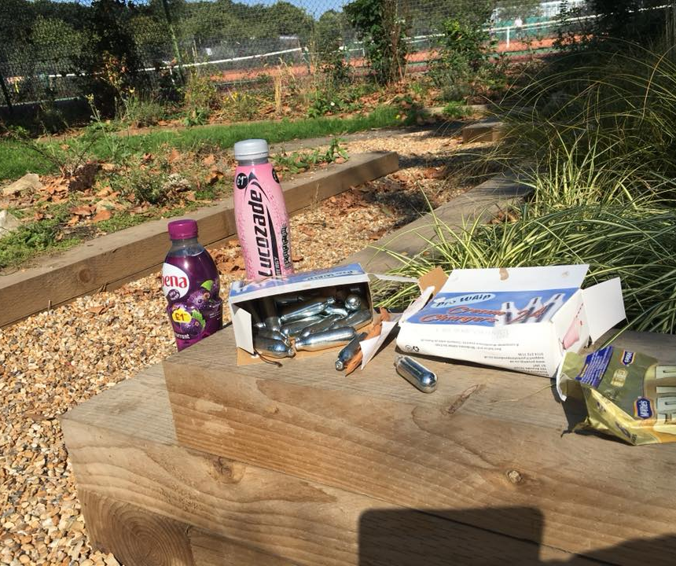
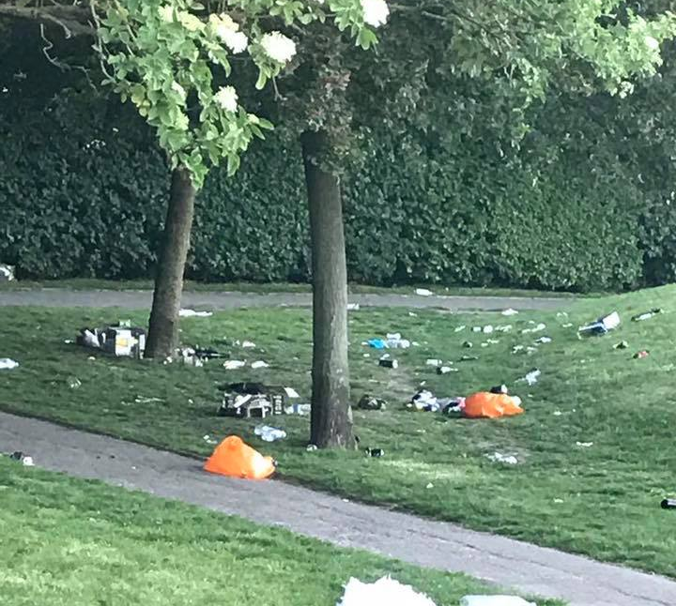
Problems in the Rec
Happily not too many
Frustratingly slow repairs to playground equipment but now in hand.
ASB: occasional graffiti on benches and playground equipment, nitrous oxide use, moped riders, inconsiderate dog owners, litter louts, destruction of notices on notice boards
One mugging – theft of mobile phone
On the whole Chislehurst and Walden Recs are friendly, safe and pleasant community spaces.

Slide 23
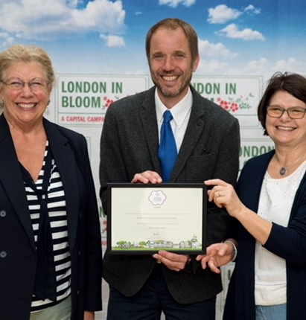
Award winning!
Barbara (right) and Mai (left) receiving Outstanding in the London in Bloom It’s Your Neighbourhood Award in September 2018.
Notes:
Fabio ??

Slide 24
AWARDS
London in Bloom It’s Your Neighbourhood
Awarded Level 5 OUTSTANDING for a 2nd year.
Judged on community involvement and environmental awareness as well as gardening skills.
Green Flag Award for a 2nd year
This is seen as the benchmark national standard for well managed publicly accessible parks and green spaces in the UK.

Slide 25
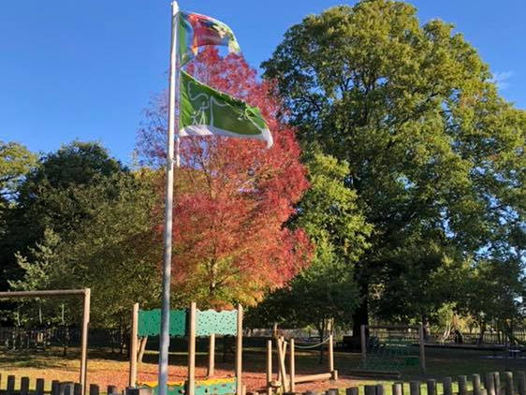

Slide 26
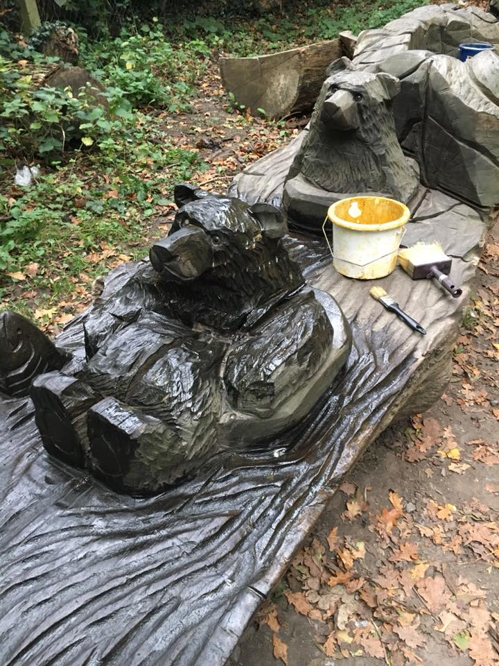
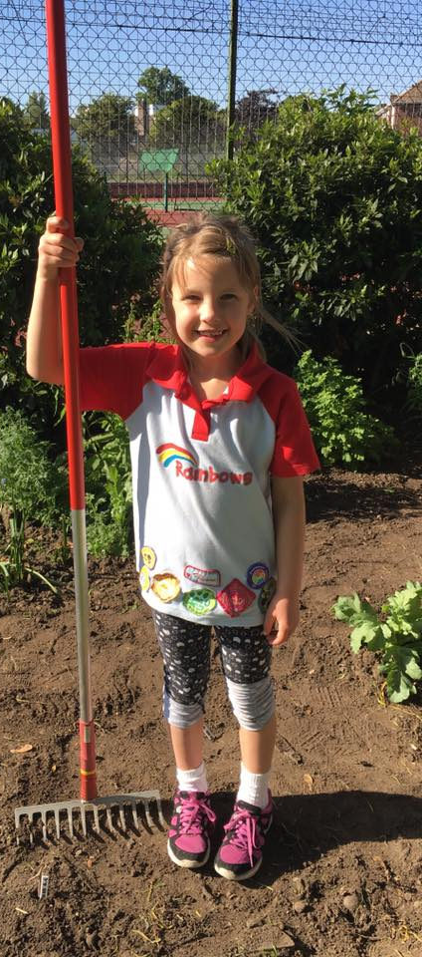
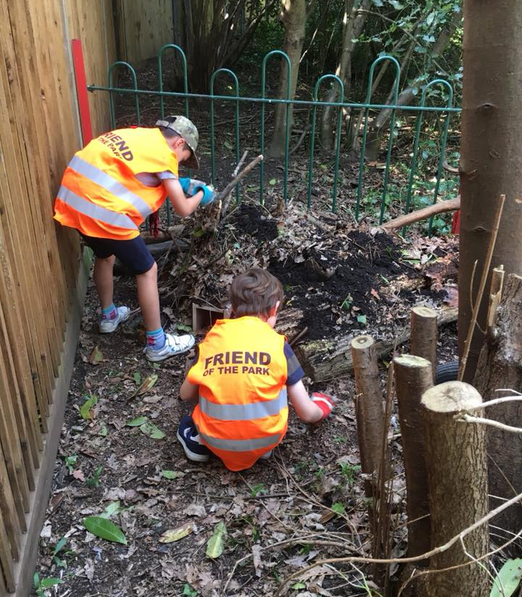
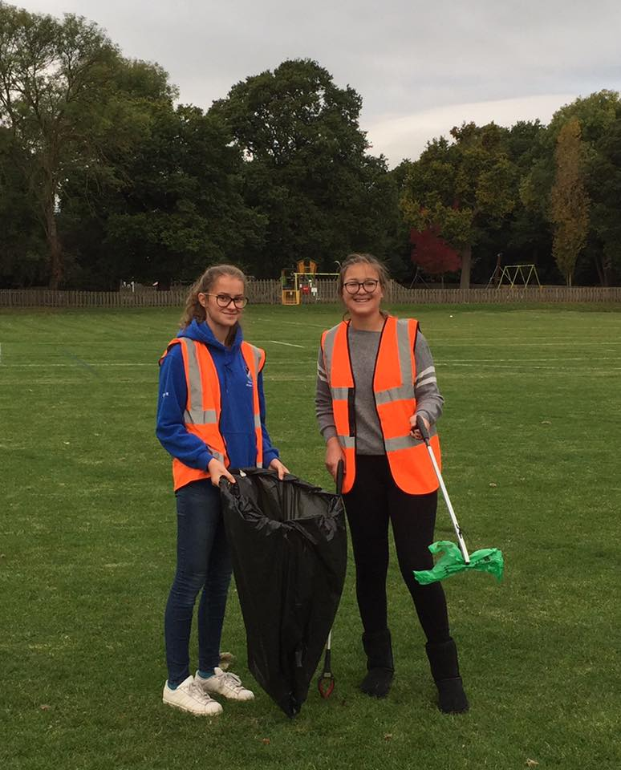
Encouraging Younger Volunteers
Duke of Edinburgh students - litter picking
Cooper’s Young Leadership Team helped with Chislehurst Rocks
1st Chislehurst Guides, Brownies and Rainbows oiled the bears and other carvings, picked litter and painted rocks for the Cub’s Rock pool project. Planted wildflowers.
Chislehurst 5th Cubs have worked regularly with us to improve the looped path area and do other jobs. We hosted them to a Bat Walk.
Chislehurst 10th Brownies and the Invicta Scout Group also help
Notes:
Barbara

Slide 27
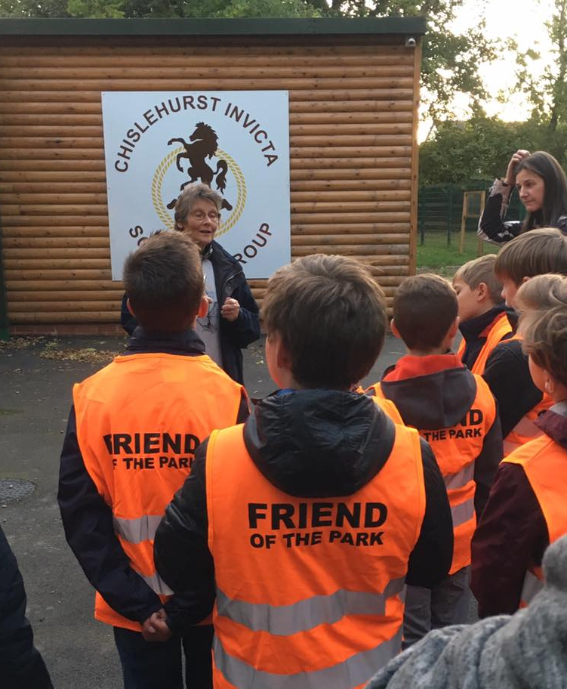
Joint ventures with the Invicta Scout Group Bat Walk Rock painting Gingerbread Houses

Slide 28
Chislehurst Rocks 30th June
Bigger and better than ever
Main stage PLUS the Chislehurst Society BR7lliant Community Stage
Thanks to our Grant Funders, Sponsors and 100 Club Members
Event was put on and cleared up by volunteers.
6 FOCRG Committee plus Mike Hasler, Mick & Mary Designs and Daniel Russell.
About 50 other people helped on the day
Special thanks go to Andrew Stammers, David Ely and the First Aid Team and Coopers Young Leadership Students
Sponsors idVerde and Shaon also provided hands on workers on the day.
WHERE DO WE GO FROM HERE ?
Notes:
Alison

Slide 29
What makes Chislehurst Rocks happen?
Chislehurst Rocks Team
6 x FOCRG committee + 5 extra
10 x other key “long day” volunteers, including first Aid Team
30 x 3 hour shift volunteers – on the day/ morning after
Months of planning, meetings, emails, phone calls, fund raising, website and social media development, finding volunteers and sponsors, booking stall holders, workshops and activities, operational plans, site map, licences, insurance, making things, listening to band’s demos, trips to wholesalers, taking deliveries, setting up and taking down, big litter pick the morning after, sort out raffle prizes, count the money, do the banking, deal with lost property, complaints and thank yous, debrief meeting …………
Total estimated hours 1624 = 45WTE
Most of this was done by about 10 key people who were also there, in the field, 7am – 11pm on the day, seeing that everything ran smoothly, including keeping the loos clean.

Slide 30
What’s Next?
January 2019
Improved management of the Agnes Whyte Bird Sanctuary.
Initial grant fund of £1680 from the Chislehurst Society to clear laurel and reduce holly.
On going
Campaign to reduce litter, especially plastic waste, in the Rec. Hopefully there will not be 1250 empty plastic bottles to make poppies next year. Encourage reusable coffee cups and water bottles

Slide 31
Spring 2019 Outdoor table tennis
Outdoor table tennis tables x 2.
Total cost with VAT £10965 Grant of £8980 from the Chislehurst Playing Field Association.

Slide 32
Ideas please
Park improvements – what are the priorities?
Paths?
Other Activities / events in the Rec
Petanque?
How to attract volunteers and future committee members. We need to share all those volunteer hours between more people!

Slide 33
Friends of Chislehurst Recreation Ground A Better Rec for All

